Slide 1

Lecture-6
Network Tools, Troubleshooting & Mini Project Ideas
Core Topics:
Tools: ping, traceroute, netstat, ipconfig, nslookup, Wireshark
Network Topologies (Bus, Star, Mesh)
Troubleshooting Basics (Latency, Packet Loss, DNS Failures)
Intro to Mini Projects: Chat App, File Transfer App, Network Monitor

Slide 2
Tools: ping, traceroute, netstat, ipconfig, nslookup, Wireshark
These are all essential network troubleshooting and diagnostic tools. Ping tests connectivity, traceroute traces the path a packet takes, netstat displays network connections and statistics, ipconfig shows network configuration, nslookup queries DNS servers, and Wireshark is a powerful packet analyzer.

Slide 3
PING
Used to test network connectivity between two devices.
Sends ICMP echo request packets and measures round-trip time.
Helps determine if a device is reachable and the latency involved.

Slide 4
How to Use Ping
Open Command Prompt or Terminal: In Windows, you can open the Command Prompt by searching for "cmd". In Linux or macOS, you can open a terminal.
Type "ping" followed by the target's IP address or hostname: For example, ping 8.8.8.8 or ping google.com.
Press Enter: The ping command will then send packets and display the results, including the RTT and any errors.

Slide 5
Traceroute
Traces the route packets take from the source to the destination.
Shows the IP addresses of each router along the path.
Helps identify potential bottlenecks or delays in network traffic.

Slide 6
How it works:
Traceroute sends packets with increasing time-to-live (TTL) values, which cause routers along the path to respond with ICMP Time Exceeded messages. This allows Traceroute to map the route to the destination.
Troubleshooting:
Traceroute can help pinpoint network issues, such as packet loss, high latency, or blocked paths.
Network Mapping:
It provides a visual representation of the data's path across the internet.
Performance Analysis:
It can identify bottlenecks in the network and measure the delay at each hop.

Slide 7
How to use it (example):
On a Linux or macOS system, you can use the command traceroute google.com. On Windows, you would use tracert google.com.
Key concepts:
Hops: Each router that a packet passes through on its journey.
Time-to-Live (TTL): A value in the IP header that specifies how many hops a packet can make before it's discarded.
ICMP (Internet Control Message Protocol): A protocol used for network diagnostics and error reporting.
Latency: The time it takes for data to travel between two points in the network.

Slide 8
Netstat
Displays active network connections, routing tables, and interface statistics.
Provides information about the status of network connections, ports, and protocols.
Helpful for troubleshooting connection issues and identifying potential conflicts.

Slide 9
Basic Usage
General usage: netstat can be used without any specific options to display a variety of network information.
Listing all active connections: netstat -a (or netstat -an for numeric addresses) will show all active TCP and UDP connections, including listening sockets.
Listing listening sockets: netstat -l will show only the listening sockets, indicating which ports are open and waiting for connections.

Slide 10
Showing routing table: netstat -r will display the routing table.
Displaying per-protocol statistics: netstat -s will show statistics for TCP, UDP, ICMP, and IP.
Showing PID and program names: netstat -tulpn (Linux) will show the PID and program names associated with each network connection.

Slide 11
Examples (Linux):
netstat -a: Shows all active connections (listening and non-listening).
netstat -tunlp: Shows TCP connections, listening ports, and PID of the process using each port (Linux).
netstat -rn: Shows the routing table with numerical addresses.
netstat -s: Displays per-protocol statistics.
Examples (Windows):
netstat -a: Shows all active connections (listening and non-listening).
netstat -ano: Shows all active connections, process ID (PID), and process name (Windows).
netstat -r: Displays the routing table.
netstat -s: Displays per-protocol statistics.

Slide 12
Ipconfig
Displays the IP address, subnet mask, default gateway, and DNS server for a computer.
Can also be used to refresh or release IP addresses.

Slide 13
Key uses of the ipconfig command
Displaying network configuration:
Running ipconfig without any parameters displays the basic TCP/IP configuration for all network adapters.
Refreshing DNS settings:
You can use ipconfig /flushdns to clear the DNS cache, which can be helpful if you're having trouble resolving domain names.
Releasing and renewing IP addresses:
ipconfig /release releases your current IP address, and ipconfig /renew renews it. This can be useful when troubleshooting DHCP issues.

Slide 14
Nslookup
Queries the DNS server for information about domain names.
Resolves domain names to IP addresses and vice versa.
Helpful for troubleshooting DNS issues and verifying domain name resolution.

Slide 15
Purpose
nslookup is used to find the IP address of a domain name, or conversely, to find the domain name associated with an IP address.
How it works:
It sends a query to a DNS server, which then retrieves the necessary information from its records.
Usage:
You can use nslookup from the command line in a terminal or command prompt.

Slide 16
Wireshark
A powerful packet analyzer that captures and analyzes network traffic.
Allows detailed examination of network packets, including headers and data.
Useful for troubleshooting complex network problems and understanding network behavior.

Slide 17
Network Protocol Analyzer:
Wireshark is designed to capture and analyze the packets of data that move through a network.
Packet Sniffing:
It's a type of packet sniffer, meaning it can capture and inspect individual data packets as they travel across the network.
Troubleshooting and Security:
Wireshark is valuable for troubleshooting network issues, identifying security vulnerabilities, and understanding network protocols.

Slide 18
Open Source and Free:
It's a free and open-source tool, making it accessible to a wide range of users, including system administrators, network engineers, and security professionals.
Real-time and Offline Analysis:
Wireshark can be used to capture data in real-time or analyze previously captured data files.
Wide Platform Support:
It runs on various operating systems, including Windows, macOS, Linux, and UNIX.

Slide 19
Network topology
Network topology is the way devices are connected in a network. It defines how these components are connected and how data transfer between the network. Understanding the different types of network topologies can help in choosing the right design for a specific network.

Slide 20
Types of Network Topology
Point to Point Topology
Mesh Topology
Star Topology
Bus Topology
Ring Topology

Slide 21
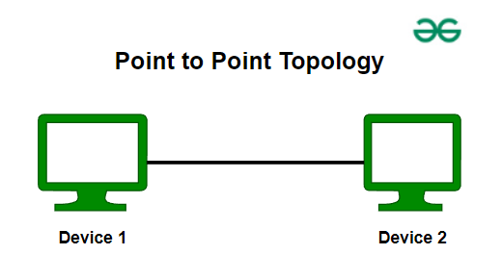
Point to Point Topology
Point-to-point topology is a type of topology that works on the functionality of the sender and receiver. It is the simplest communication between two nodes, in which one is the sender and the other one is the receiver. Point-to-Point provides high bandwidth.

Slide 22
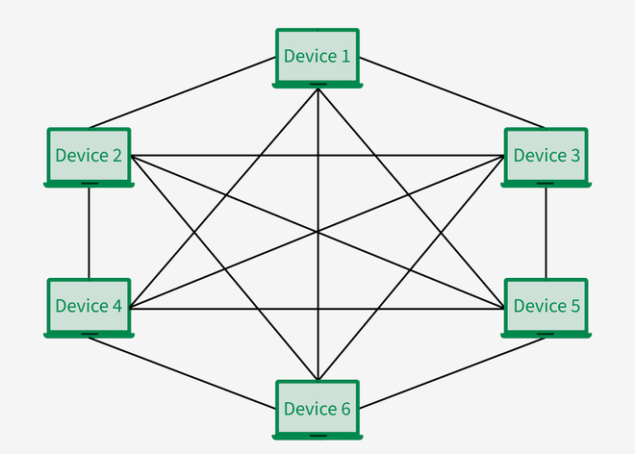
Mesh Topology
In a mesh topology, every device is connected to another device via a particular channel. Every device is connected to another via dedicated channels. These channels are known as links. In Mesh Topology, the pro tocols used are AHCP (Ad Hoc Configuration Protocols), DHCP (Dynamic Host Configuration Protocol), etc.

Slide 23
Advantages of Mesh Topology
Communication is very fast between the nodes.
Mesh Topology is robust.
The fault is diagnosed easily. Data is reliable because data is transferred among the devices through dedicated channels or links.
Provides security and privacy.

Slide 24
Disadvantages of Mesh Topology
Installation and configuration are difficult.
The cost of cables is high as bulk wiring is required, hence suitable for less number of devices.
The cost of maintenance is high.

Slide 25
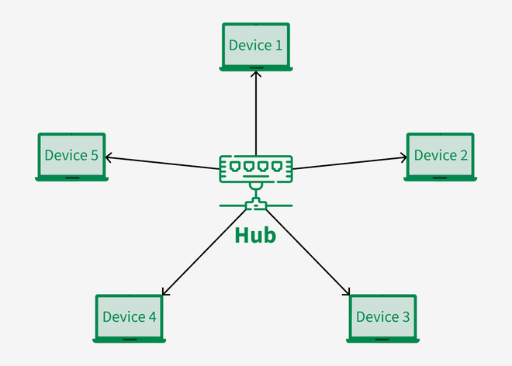
Star Topology
In Star Topology, all the devices are connected to a single hub through a cable. This hub is the central node and all other nodes are connected to the central node. The hub can be passive in nature i.e., not an intelligent hub such as broadcasting devices, at the same time the hub can be intelligent known as an active hub.

Slide 26
Advantages of Star Topology
If N devices are connected to each other in a star topology, then the number of cables required to connect them is N. So, it is easy to set up.
Each device requires only 1 port i.e. to connect to the hub, therefore the total number of ports required is N.
It is Robust. If one link fails only that link will affect and not other than that.
Easy to fault identification and fault isolation.

Slide 27
Disadvantages of Star Topology
If the concentrator (hub) on which the whole topology relies fails, the whole system will crash down.
The cost of installation is high.
Performance is based on the single concentrator i.e. hub.

Slide 28
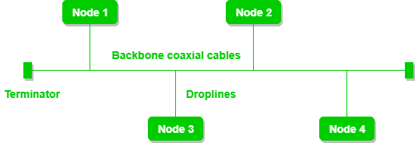
Bus Topology
Bus Topology is a network type in which every computer and network device is connected to a single cable. It is bi-directional. It is a multi-point connection and a non-robust topology because if the backbone fails the topology crashes.

Slide 29
Advantages of Bus Topology
If N devices are connected to each other in a bus topology, then the number of cables required to connect them is 1, known as backbone cable, and N drop lines are required.
Coaxial or twisted pair cables are mainly used in bus-based networks that support up to 10 Mbps.
The cost of the cable is less compared to other topologies, but it is used to build small networks.
Bus topology is familiar technology as installation and troubleshooting techniques are well known.

Slide 30
Disadvantages of Bus Topology
A bus topology is quite simpler, but still, it requires a lot of cabling.
If the common cable fails, then the whole system will crash down.
If the network traffic is heavy, it increases collisions in the network. To avoid this, various protocols are used in the MAC layer known as Pure Aloha, Slotted Aloha, CSMA/CD, etc.
Adding new devices to the network would slow down networks.
Security is very low.

Slide 31
Ring Topology
In a Ring Topology, it forms a ring connecting devices with exactly two neighboring devices. A number of repeaters are used for Ring topology with a large number of nodes, because if someone wants to send some data to the last node in the ring topology with 100 nodes, then the data will have to pass through 99 nodes to reach the 100th node. Hence to prevent data loss repeaters are used in the network.

Slide 32
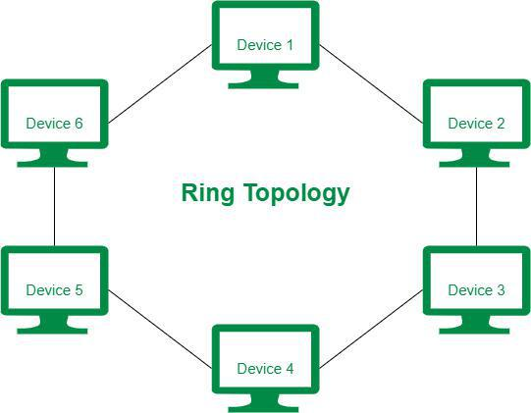

Slide 33
Operations of Ring Topology
One station is known as a monitor station which takes all the responsibility for performing the operations.
To transmit the data, the station has to hold the token. After the transmission is done, the token is to be released for other stations to use.
When no station is transmitting the data, then the token will circulate in the ring.

Slide 34
Advantages of Ring Topology
The data transmission is high-speed.
The possibility of collision is minimum in this type of topology.
Cheap to install and expand.
It is less costly than a star topology.

Slide 35
Disadvantages of Ring Topology
The failure of a single node in the network can cause the entire network to fail.
Troubleshooting is difficult in this topology.
The addition of stations in between or the removal of stations can disturb the whole topology.
Less secure.

Slide 36
Troubleshooting Basics (Latency, Packet Loss, DNS Failures)
Troubleshooting latency, packet loss, and DNS failures starts with verifying basic connectivity, then moves to identifying the specific issue (local network or destination) and using tools like ping and traceroute to pinpoint problems. For packet loss, consider factors like network congestion, wireless interference, or hardware issues. For DNS failures, ensure your DNS server is accessible and try flushing your DNS cache.

Slide 37
Verify Connectivity
Ping:
Use the ping command (e.g., ping google.com) to test connectivity to a known website or IP address. If you receive replies, your internet connection is likely working.
Traceroute:
If ping fails, use traceroute to identify potential bottlenecks along the network path to the destination.

Slide 38
Check Network Devices: Restart routers and other network devices.
Disconnect Devices: Temporarily disconnect other devices on your network to see if they're causing congestion.
Use Wired Connection: If possible, switch to an Ethernet connection for a more stable and faster connection.
Check Server Location: Latency can also be affected by the distance to the destination server.

Slide 39
Troubleshooting Packet Loss:
Check Network Hardware: Ensure routers, modems, and cables are functioning properly.
Optimize Network Settings: Configure Quality of Service (QoS) to prioritize critical traffic.
Minimize Congestion: Avoid bandwidth-intensive tasks during peak hours.

Slide 40
Increase Bandwidth: If network congestion is a major issue, consider increasing bandwidth.
Run Ping Tests with Packet Loss: Use tools like PingPlotter to track packet loss and identify where it's occurring.
Check Network Statistics: Some applications allow you to enable network statistics to track packet loss.

Slide 41
Troubleshooting DNS Failures:
Verify DNS Server: Ensure your DNS server is accessible and not causing issues.
Flush DNS Cache: Use the ipconfig /flushdns command (Windows) to clear your DNS cache.
Change DNS Settings: Consider using a different DNS server like Cloudflare (1.1.1.1).

Slide 42
General Troubleshooting Steps:
Restart Devices: Power cycle routers, modems, and computers.
Update Firmware: Ensure your router and other network devices have the latest firmware.
Contact ISP: If issues persist, contact your Internet Service Provider (ISP) to check for outages or problems with your connection.
Consider Network Monitoring Tools: Use tools like PingPlotter or SolarWinds to monitor network performance and identify potential issues.

Slide 43
Intro to Mini Projects: Chat App, File Transfer App, Network Monitor
These are all great project ideas for exploring network programming concepts. A chat app allows for real-time communication, a file transfer app demonstrates file sharing, and a network monitor helps visualize network activity.
Chat App:
Concept: A chat app enables users to send and receive text messages in real-time.

Slide 44
Implementation: This can involve creating a client-server architecture where clients connect to a server to send and receive messages.
Technology: Socket programming (e.g., using Python's socket module) is a fundamental starting point for building a chat app. You can also explore frameworks like Socket.IO for more complex features.

Slide 45
File Transfer App:
Concept:
A file transfer app allows users to share files between different computers or devices.
Implementation:
This involves handling file uploads and downloads, potentially using TCP or UDP protocols.
Technology:
Socket programming and basic file I/O operations are key. You could also explore more advanced file transfer protocols like HTTP for web-based file sharing.

Slide 46
Concept:
A network monitor helps visualize network activity, such as packet loss, latency, and bandwidth usage.
Implementation:
This typically involves using network sniffing tools and data analysis libraries.
Technology:
You could use libraries like Scapy for network packet sniffing, or tools like Wireshark for more in-depth analysis.

